Slide 1
Code Club
Week 4
Loops
bit.ly/CCFULHAM

Slide 2
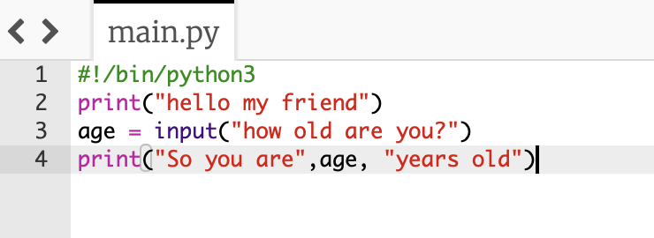
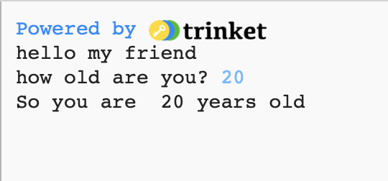
So Far we learned about:
Python Commands
print()
input()
randint()
Week 1 – Exercise*

Slide 3
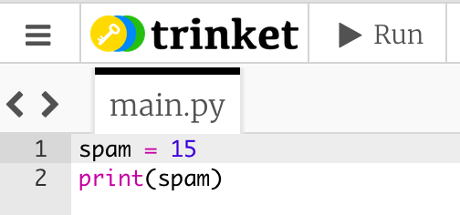
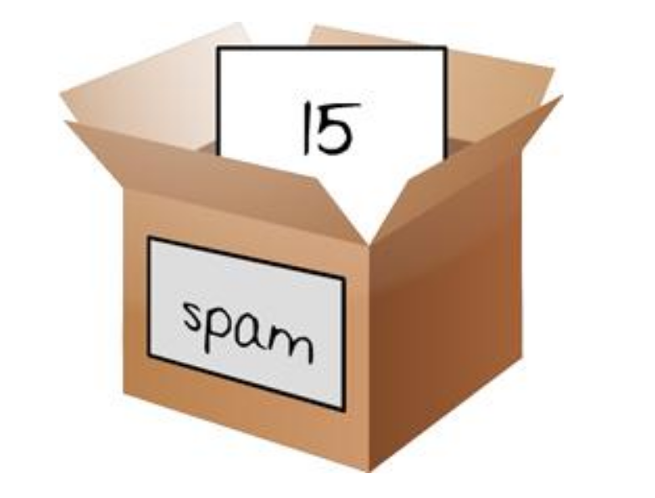
So Far we learned about:
Variables
The boxes where we store values
Week 1 and 2 – Exercise*

Slide 4
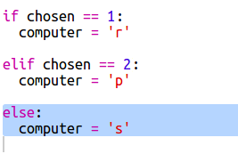
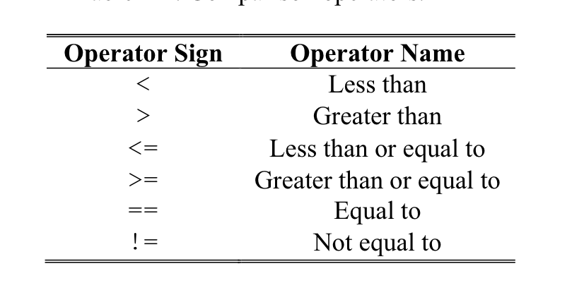
So Far we learned about:
Conditions
Evaluates if something is TRUE or FALSE
Week 2 – Exercise*

Slide 5
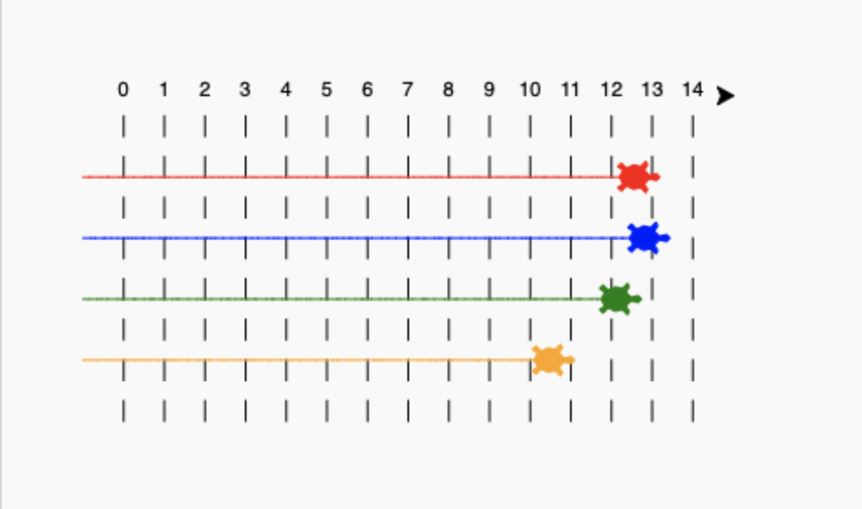

So Far we learned about:
Loops
Repetition
Today we will learn more about them
Week 3 – Exercise*

Slide 6

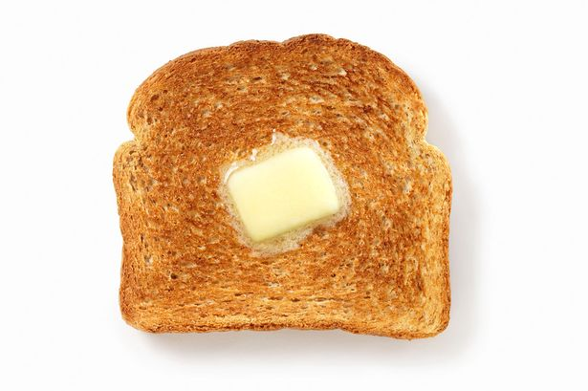
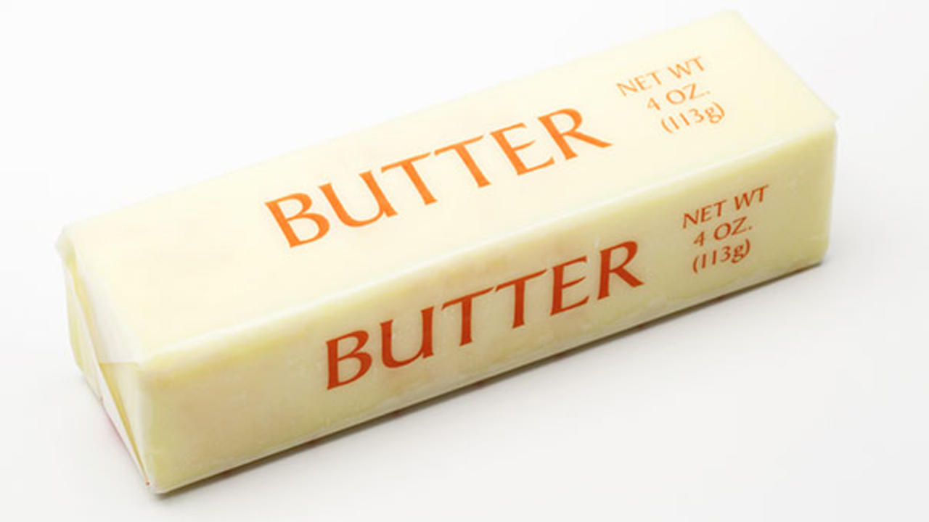
Lets think of program to do the following
+
=

Slide 7
How would you write it?
Gather ingredients
Get Knife
Spread the butter on a toast
+
=

Slide 8
What if we want 100 toasts with butter?

Slide 9
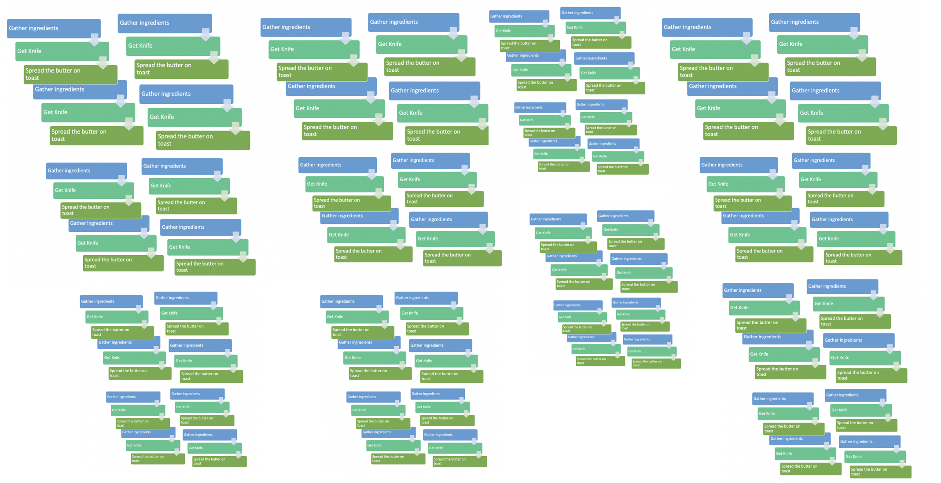
Should we do like this?

Slide 10
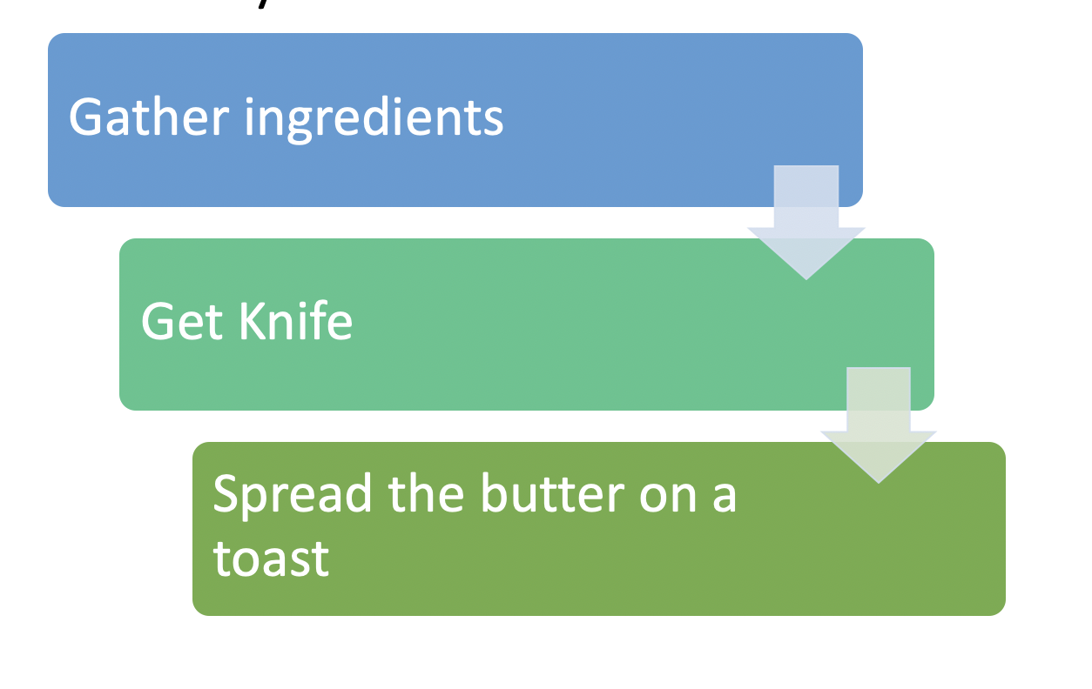
Loops
Whenever we want to repeat a set of instructions we use a Loop Block
We are going to se 2 kinds of loops
While Loop and For Loop

Slide 11
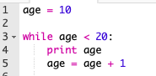
While loops
While loops tell the computer to do something while something else is true. For example
We read it: While age is less than 20 print age and increase it by 1

Slide 12
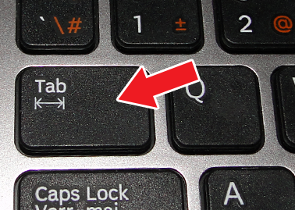
Let’s run the code - bit.ly/CCFULHAM
Click “start a blank code here”
Hint: These “blank spaces” are very important. To the loop block.
To have them, press the TAB Key

Slide 13
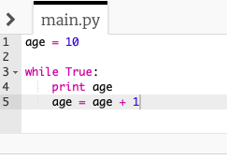
While loops
While loops will automatically stops (break out of the loop) once the condition becomes false.
For example: age >= 20
Question: What happens if the condition is never false?
Update your loop condition

Slide 14

Infinite loops

Slide 15
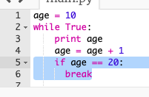
Infinite loops
They are bad programming
Eventually the computer will crash (out of memory)
Always check the break condition of your loop and make sure it will be achieved
Is the same as

Slide 16
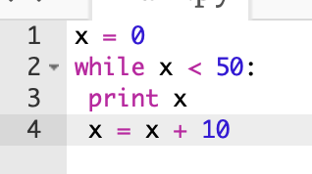
Challenge – What is the output?
0
10
20
30
40

Slide 17
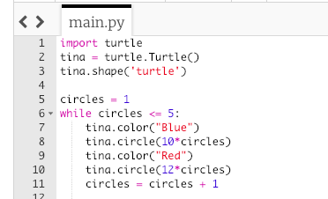
Let’s Code!

Slide 18
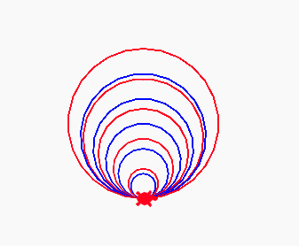
Result

Slide 19
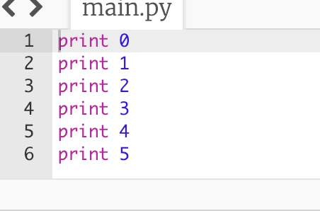
For Loop
For loops tell the computer to do something for a bunch of values.
They're particularly useful when we want the same "thing" done several times in succession.
Let's say, for example, we wanted to print out the numbers 0-5 in sequence. We could write print statements:

Slide 20
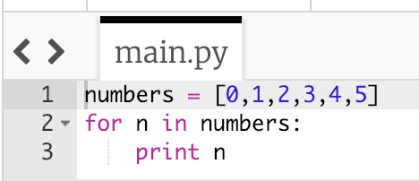
For Loop
We could also put the numbers we want in a list and then print each thing in the list:
0
1
2
3
4
5

Slide 21
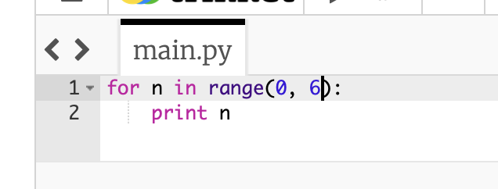
For Loop
When you don’t have a list Python can create one using the range() function
Example: range(0,6)
Create a list that starts with 0 and have length 6
In other words: [0,1,2,3,4,5]

Slide 22
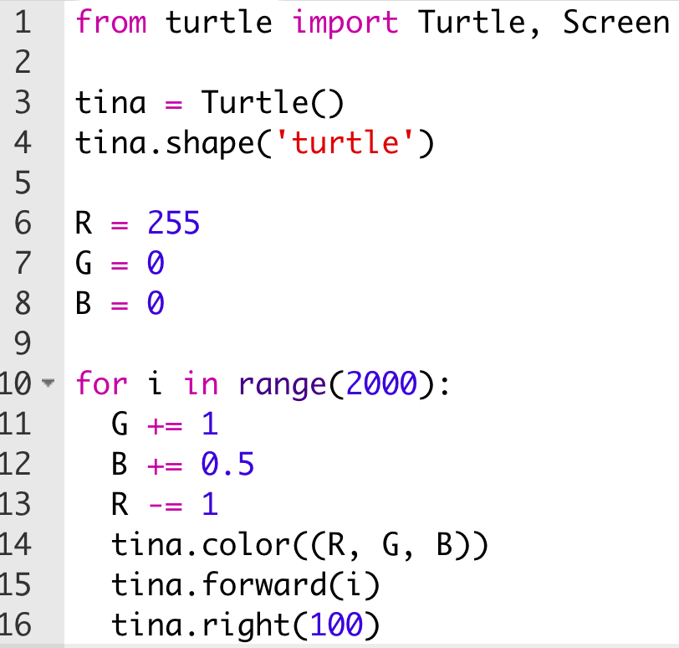
Let’s Code!

Slide 23
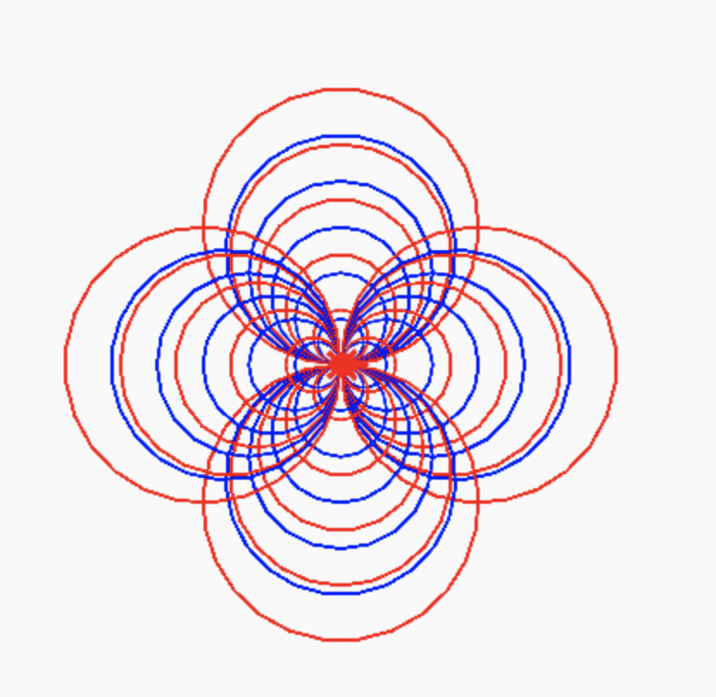
Challenge Any idea how to produce this?
Hint, you can combine
While and For Loops

